Slide 1

Welcome

Slide 2

Midterm is over

Slide 3

23/12

Slide 4
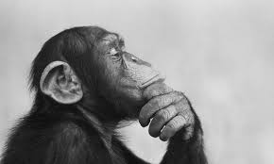
What have we done ? & where have we stopped ?

Slide 5
Introduction about wind turbines .
Choosing type of the turbine (VWAT) .
Choosing type of VWAT (Gorlov) .
Book introduction .
Proposal template .
CAD model .
Mathematical models for the physical problem .

Slide 6


Slide 7
Solving the mathematical model manually .
Solving the mathematical model using MATLAB .
Solving the mathematical model CFD & FEA .
Writing proposal for the scientific research institution .
Writing proposal for unilever .
Competition .

Slide 8

Meeting chairperson

Slide 9
Responsibilities :
Meeting time & place .
Black box .
Fill the meeting template .

Slide 10

Meeting template
‘Name’_‘meeting number’

Slide 11


